Slide 1

Importance of Skill Optimization in Challenging Times
Ajaiya Kumar Pandey
Oct 10, 2021

Slide 2
WEBINAR OVERVIEW
Skill : Professional vs Personal Skills
Skill Optimization : Upskilling or Reskilling
The Need of Skill Optimization !
How/When/Where do we need to Up-skill or Re-skill ourself ?

Slide 3
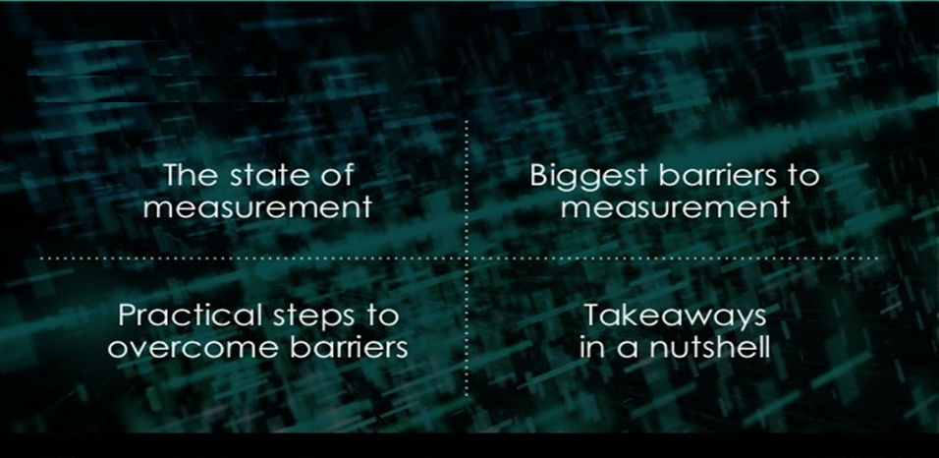
SKILL MEASUREMENT
Fibonacci series >>>> 0, 1, 2, 3, 5, 8, 13
Awareness : Comfort Zone | Start > Control
Innovative reward for ourself
Build Purpose Driven Story

Slide 4
SKILLs
Professional vs Soft Skills
Professional Skill | Soft Skill ‘Core’
Industrial Skill Technical Skill - Hardware vs Software | Commercial/Business/industry Know our Organization Communications Teamwork Negotiation and persuasion Problem solving Leadership Perseverance and motivation Collaboration

Slide 5
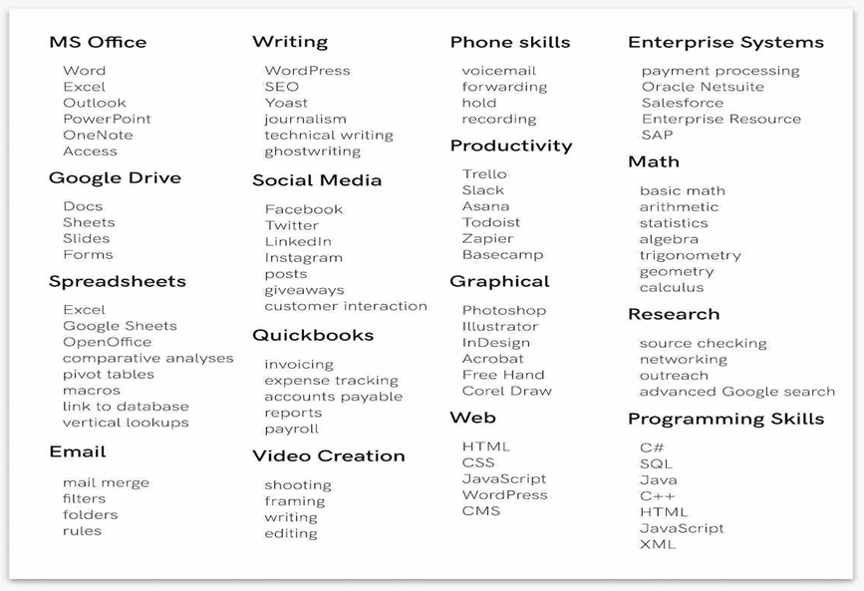
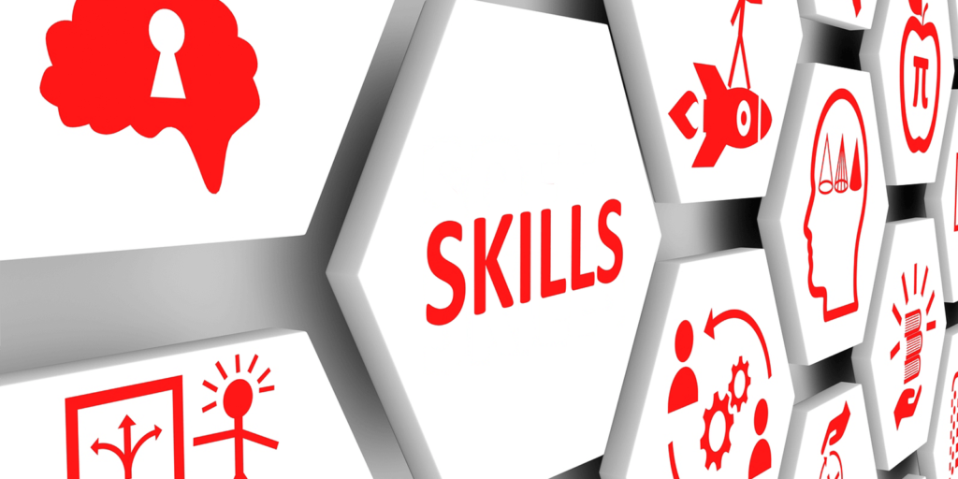
PROFESSIONAL SKILL
Technical Skills

Slide 6
IT Skills
Web. HTML5, CSS, Django, Node.js. Laravel, React.
Programming Skills. C#, Java, C++, JavaScript, Python, PHP, Objective-C, AJAX, ASP.NET, Ruby, Golang. Reactive Java, Spring Boot
Blockchain technologies. Bitcoin, Ripple, Ethereum, Bitcoin Cash, Monero, Litecoin.
Mobil Apps
Cloud and Distributed Computing. Kubernetes, Docker, Azure, AWS.
Machine Learning. TensorFlow, scikit-learn, Google Cloud ML Engine, AML.
Operating Systems. Microsoft, Windows, macOS, Linux.
Network and Information Security. OSCP, CISSP, Cisco CCNA, Certified Ethical Hacker (CEH), CompTIA Security+.
Electronic and Electrical Engineering. AutoCAD, MATLAB, Verilog, Simulink, Pspice, Multisim, ETAP.
Virtualization. VMware vSphere, Microsoft Hyper-V, QEMU, Oracle VM VirtualBox, XEN.
Big Data. Statistical analysis, data mining and modeling, database management.
eCommerce Platforms. Magento, PrestaShop, Joomla, OpenCart, WooCommerce, Shopify.
Delivery Skill.
Team Management Skill.
Agility Skill.
Adoption Skill

Slide 7
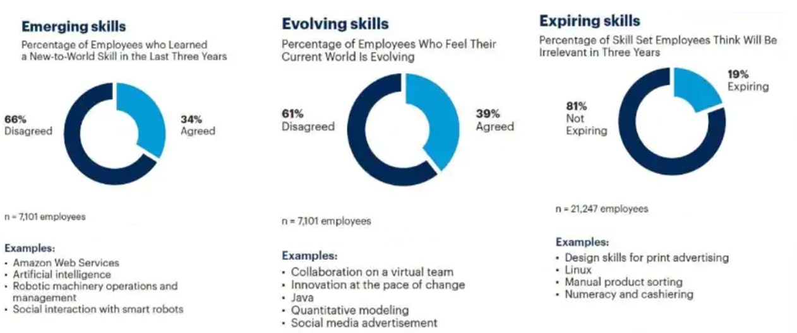
Why Upskilling Our responsibility over Time ?
The client’s new requirement introduces new Skill !

Slide 8
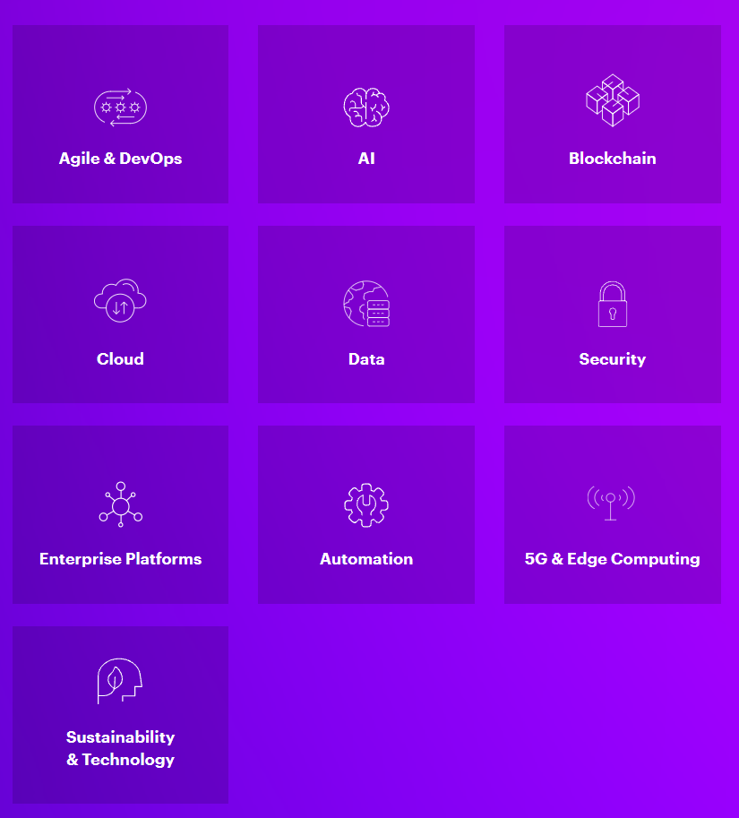
Technology Quotient

Slide 9
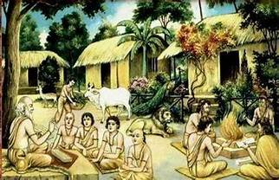
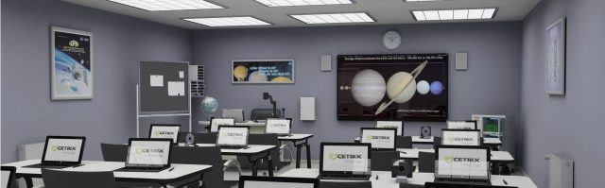
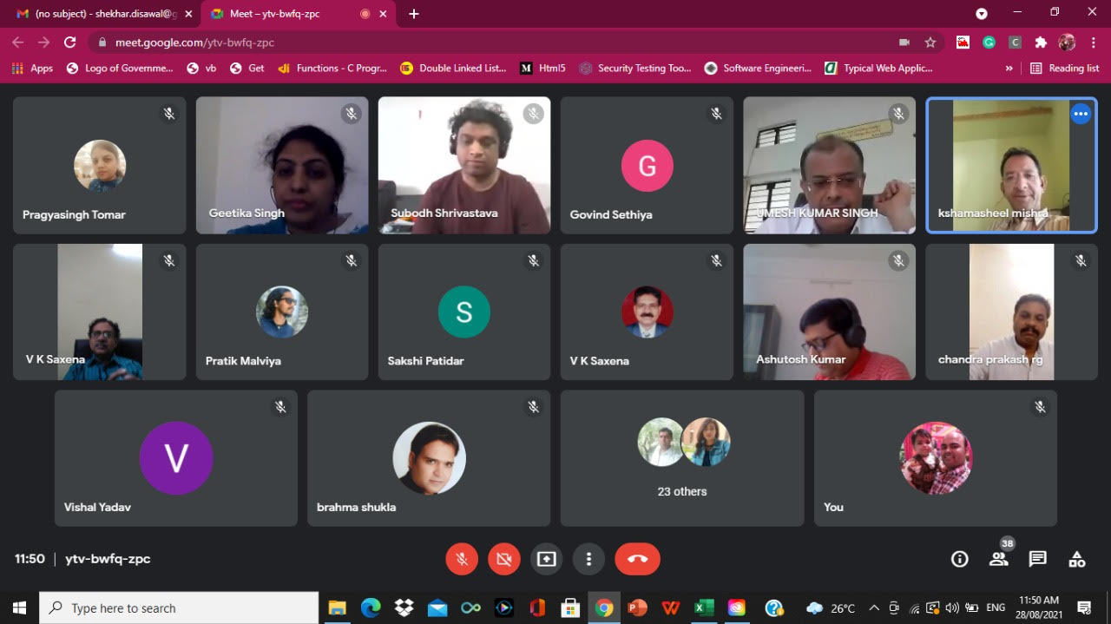
OUR DIGITAL FUTURE ?
Ancient Pattern
Recent Pattern
Digital Era
... and yet WE are learning what it means to BE digital ?
Manufacturing Medical Military Retail Agriculture | GPS Automotive Consumer Electronics Transportation | AI VR & AR Machine Learning Voice Recognition Internet Of Things (IoT) | IT Telecommunication Trainings Entertainment

Slide 10

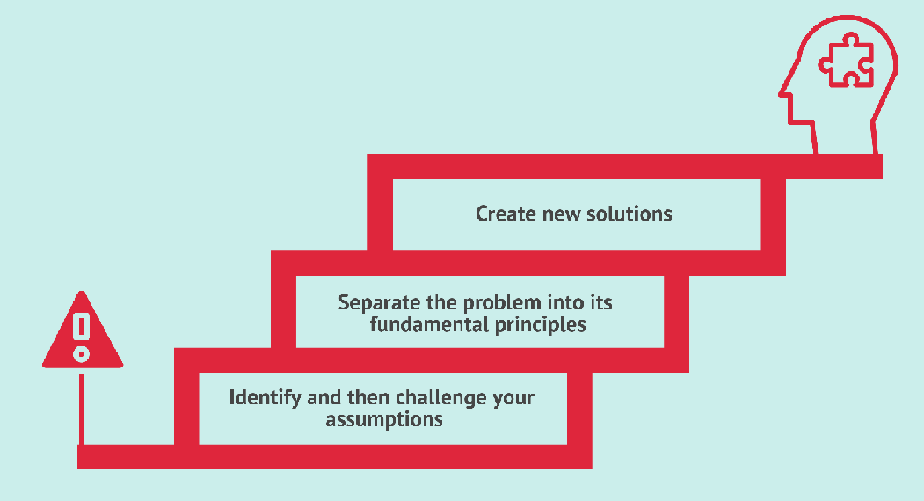
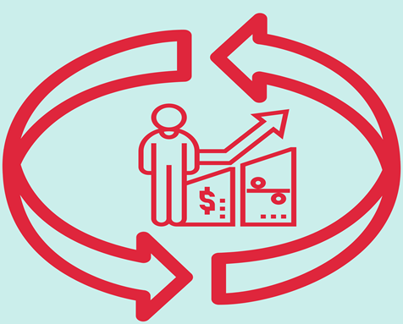
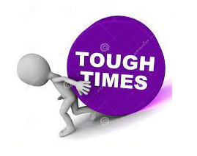
Takeaway in a nutshell
First Principal : Thinking
Pygmalion Effect
Higher expectations lead to an
increase in performance ☺ ☺

Slide 11
Personal Skills
Soft Skill >> CORE in any Industry or Organization or @ Planet @
Commercial/Business/industry : What makes a company strong ? Know Our Organization Communication vs Effective Communication Teamwork Negotiation and persuasion Problem solving Leadership Perseverance and motivation Collaboration

Slide 12
Skill Optimization
Up-skilling (++)
or Re-skilling
Some changes post COVID-19 like up-skilling and re-skilling for everyone’s learning will remain relevant.
We all have needed to make adjustment when the pandemic hit & we adopted a more digital way of life.
Used several new platforms. Everyone in a small or bigger space get benefits from upskilling.
Employees gain new skills, companies become more diverse in skill sets they can offer their customers and company culture becomes stronger.
That’s why up-skilling is important for all of us.

Slide 13
Skill Optimization
Re-skilling (+)
Up-skilling
Re-skilling >> Is train to employees for a totally new job skill.
As today’s world is ever changing some job roles may be extinct all together while new roles may pop up.
With this constant shift, company culture changes and reskilling is a great way to fill new opportunities with current employees.
That’s why re-skilling are important for all of us in this world.

Slide 14


Advantages of up-skilling /re-skilling
Up
skilling
Re
Improves employee retention
Helps company culture
Increases customer satisfaction
Attract new and more qualified employees

Slide 15
Implementation of up-skilling & re-skilling
How to implement up-skilling and re-skilling for employee training?
Up
skilling
Re
Create a Short/Long team Goal
Evaluate often
Define company objectives
Self evaluation

Slide 16
What types of training works best for up-skilling?
Up-skilling
Subject matter experts
Breakout sessions
Microlearning
Technology-driven

Slide 17
What type of training works well for re-skilling?
Re-skilling
Industry courses & Certifications
Coaching
Job shadowing
mLearning
Train to transition

Slide 18
Importance of Up-skilling & Re-skilling
Why is
up-skilling and re-skilling becoming more important
The ability to adapt and change is more important than ever , no matter what industry you are in.
The more up-skilling or re-skilling you can adopt, the more agile your career .

Slide 19



HOW do we UP-SKILL ?
Active Learning
Understanding Benefits, Tips and Techniques
Collaborative Learning
Strategies and Benefits
The Buddy System
Objective-Oriented Training
Mix and Match Your Teams
Active Listening
Improving Comprehension Skills

Slide 20
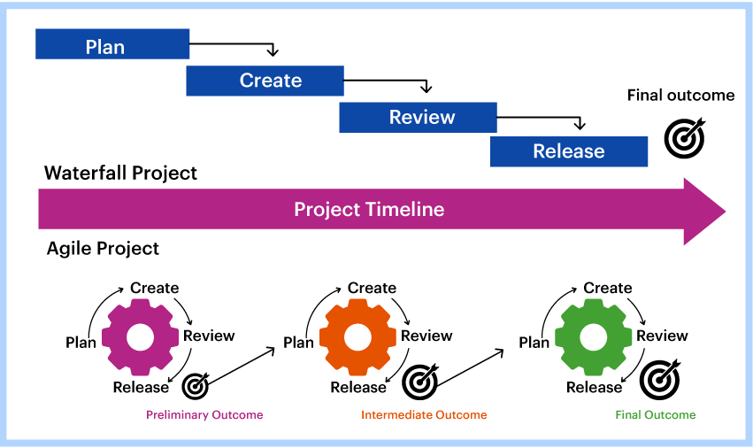
BE AGILE FOR UP-SKILING !

Slide 21
AS-ONE
Aspire
A
Self Starter
S
Own It
O
New Day
N
Energize
E

Slide 22
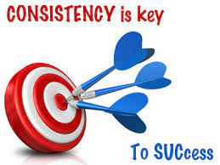

Slide 23
Leaders –
Knows the Way
Goes to the Way
Shows the Way

Slide 24

Thanks so much …..
ICS Family …
My lovely family
BEST WISHES…
ajaiyapandey@gmail.com
Cell: (+1) 309-533-5880

